Slide 1




How do fathers affect their children’s education?
An Ideas in Practice event,
Leeds University Business School
20th September 2023, 11.30-13:30 (online)

Slide 2
Welcome from Andrew Gwynne MP
Shadow Social Care Minister and Chair of the All-Party Parliamentary Group on Fatherhood
Notes:
Andrew appointed Shadow Social care minister last week

Slide 3
How do fathers affect their children’s education?
Findings from the PIECE study
Dr Helen Norman
Principal Investigator (& Senior Research Fellow, University of Leeds) h.norman@leeds.ac.uk
Paternal Involvement and its Effects on Children’s Education (PIECE) study
Final Report Launch: 20th September 2023

Slide 4


Why dads?

Slide 5
Time Use of fathers and mothers (with a dependent child aged <16), 2015
Source: UK Time Use Survey (Wishart et al 2019)
Notes:
Note
non-routine housework (e.g. shopping), interactive childcare (playing) and other types of childcare (e.g. supervision, travelling etc).

Slide 6
How do fathers feel about the amount of time they spend with their child (aged 5)?

Slide 7

Barriers to fathers’ involvement
The father themselves (e.g., motivation, confidence)
Long paid work hours
Lack of flexible work (& perceived availability of flex work)
Unsupportive line managers
Parental leave (or lack of)
Gender role attitudes & cultural norms
The gender pay gap (earnings)
Parental relationship conflict
Notes:
So what effect might this variability in father involvement have on their children? Might it have diff consequences?

Slide 8
Does fathers’ involvement affect child outcomes?
What do we already know?
Parental childcare involvement critical for supporting children’s development - based on research with mothers/’parents’ e.g.
  Engagement in educational or structured as opposed to unstructured activities is associated with better primary school grades (e.g. Del Bono et al 2016; Hsin and Felfe, 2014)
Little evidence to show whether and how fathers impact on children’s education - independent of mothers
Could paternal childcare involvement have different consequences for children’s educational development?

Slide 9
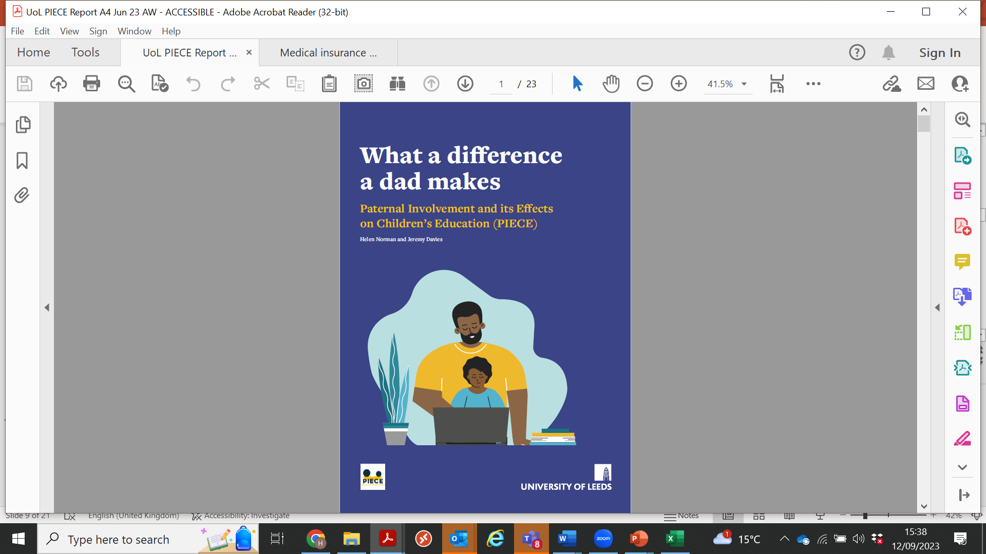

Funded by the ESRC Secondary Data Analysis Initiative
1 April 2021 – 30 June 2023
Dr Helen Norman (PI), Leeds University Business School
Dr Jeremy Davies (Co-I), Fatherhood Institute
Professor Mark Elliot (Co-I), University of Manchester
Professor Colette Fagan (Co-I), University of Manchester
Dr Rose Smith (Research Fellow), Leeds University Business School
www.piecestudy.org
@PIECEStudy

Slide 10

Research Questions
Does father engagement Increase primary school attainment for children?
Does father engagement enhance other aspects of the child’s development – such as their emotional, conduct and pro-social behaviour?
Does pre-school father engagement affect later educational attainment for children when they are at primary school?
Does father engagement have a stronger effect on children’s attainment in particular academic subjects e.g., like English and Maths?
Which father engagement activities are the most important?
Does father engagement help to reduce the well-known negative effects of poverty on children’s educational attainment?
Is father engagement important for boys, girls or does gender not matter?
What other factors influence a child’s attainment at primary school?

Slide 11

What did we do?
Statistical analysis of a longitudinal survey of 5,000 (mother-father) households in England from the Millennium Cohort Study.
Fathers and Children’s Learning survey (248 UK fathers in 2022)
2 x consultation forums in 2022: (i) 7 dads (ii) 8 representatives from educator orgs & groups.
3rd forum hosted by Learning with Parents (Jan 2023).

Slide 12
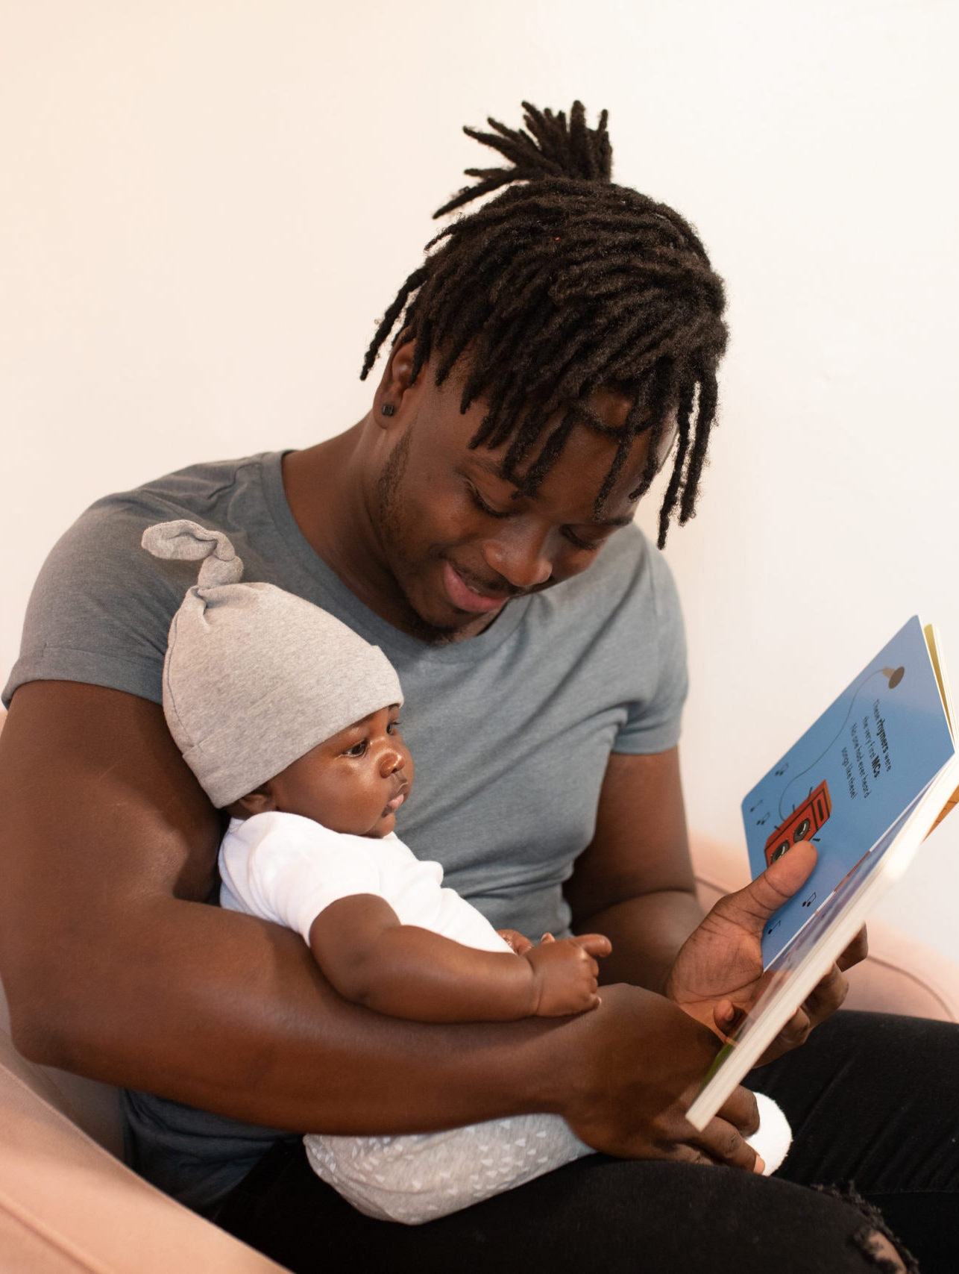
Data

Slide 13
Longitudinal Data
Five sweeps of the Millennium Cohort Study (MCS):
Sweep | Date | Child’s age
1 | 2000-02 | 9 months
2 | 2004 | 3 years
3 | 2006 | 5 years
4 | 2008 | 7 years
5 | 2012 | 11 years

Slide 14
1) Measuring Father (and mother) involvement
How often do you do the following with your child:
Read [READ]
Tell stories [STORY]
Play music, sing songs, dance, musical
activities [MUSIC]
Play toys or games indoors [TOYS]
Play sports/physically active games outdoors [GAME]
Take your child to the park or outdoor playground [PARK]
Draw, paint, make things [PAINT]
*All measured on a Likert scale: Not at all; Less often than once a month; Once or twice a month; Once or twice a week; Several times a week; Every day or almost every day.

Slide 15
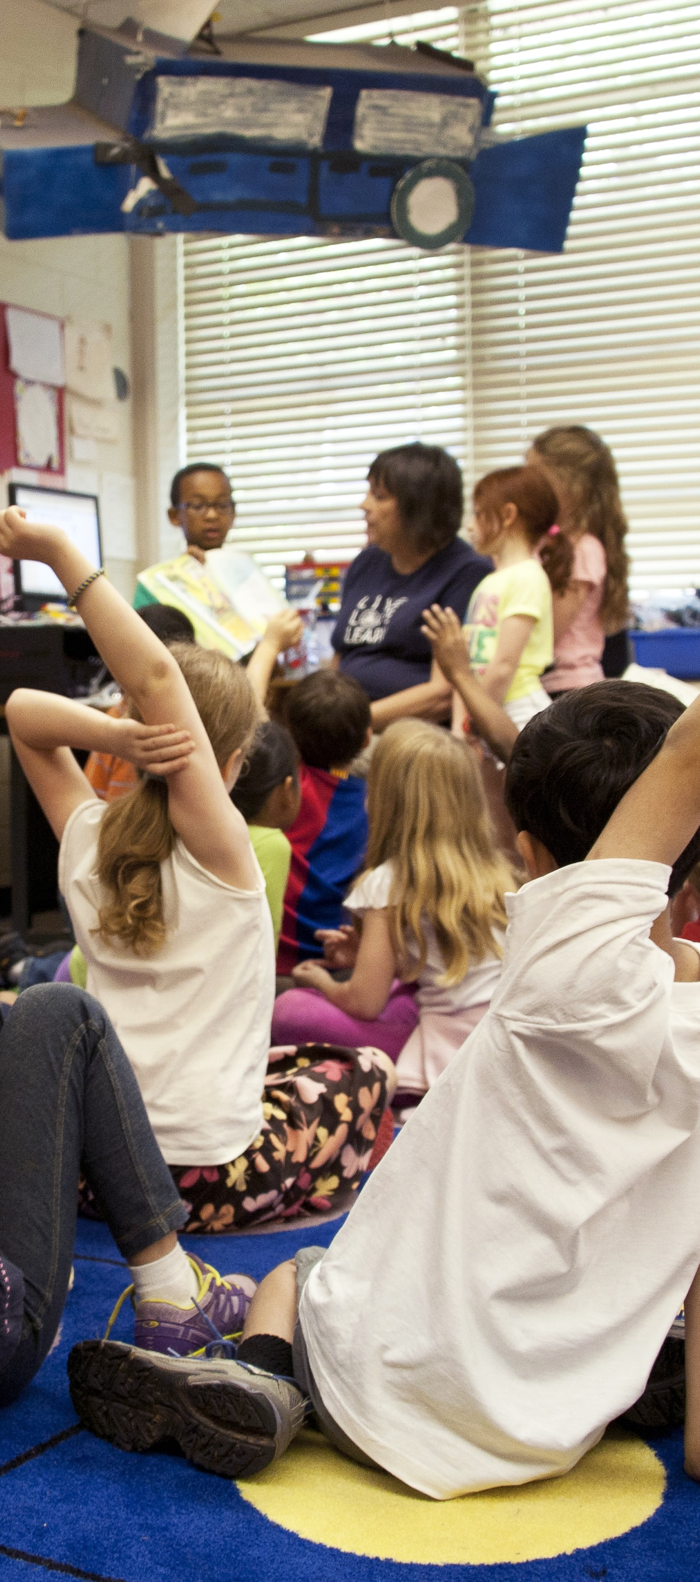
2) Measuring educational attainment
Early Years Foundation Stage Profile – age 5
    Personal, social & emotional development
    Communication, language & literacy
    Mathematical development
    Knowledge & understanding of the word
    Physical development
    Creative development
Key Stage 1 – age 7
    Maths
    Speaking & listening, Writing, Reading
    Science
Notes:
NB: The FSP captures the ‘Early Learning Goals’ as a set of 13 assessment scales (shown in the right col) which map across six broad areas of learning (shown on the left col).
For each assessment scale, the teacher gives the child 1–9 points. Adding all the assessment scales together gives a continuous scale of 0-117 points… However, again we generated a latent factor of ‘attainment’ using the 13 assessment scales (or variables) shown in the Table so our measure is a latent (composite) measure of attainment across all these scales

Slide 16
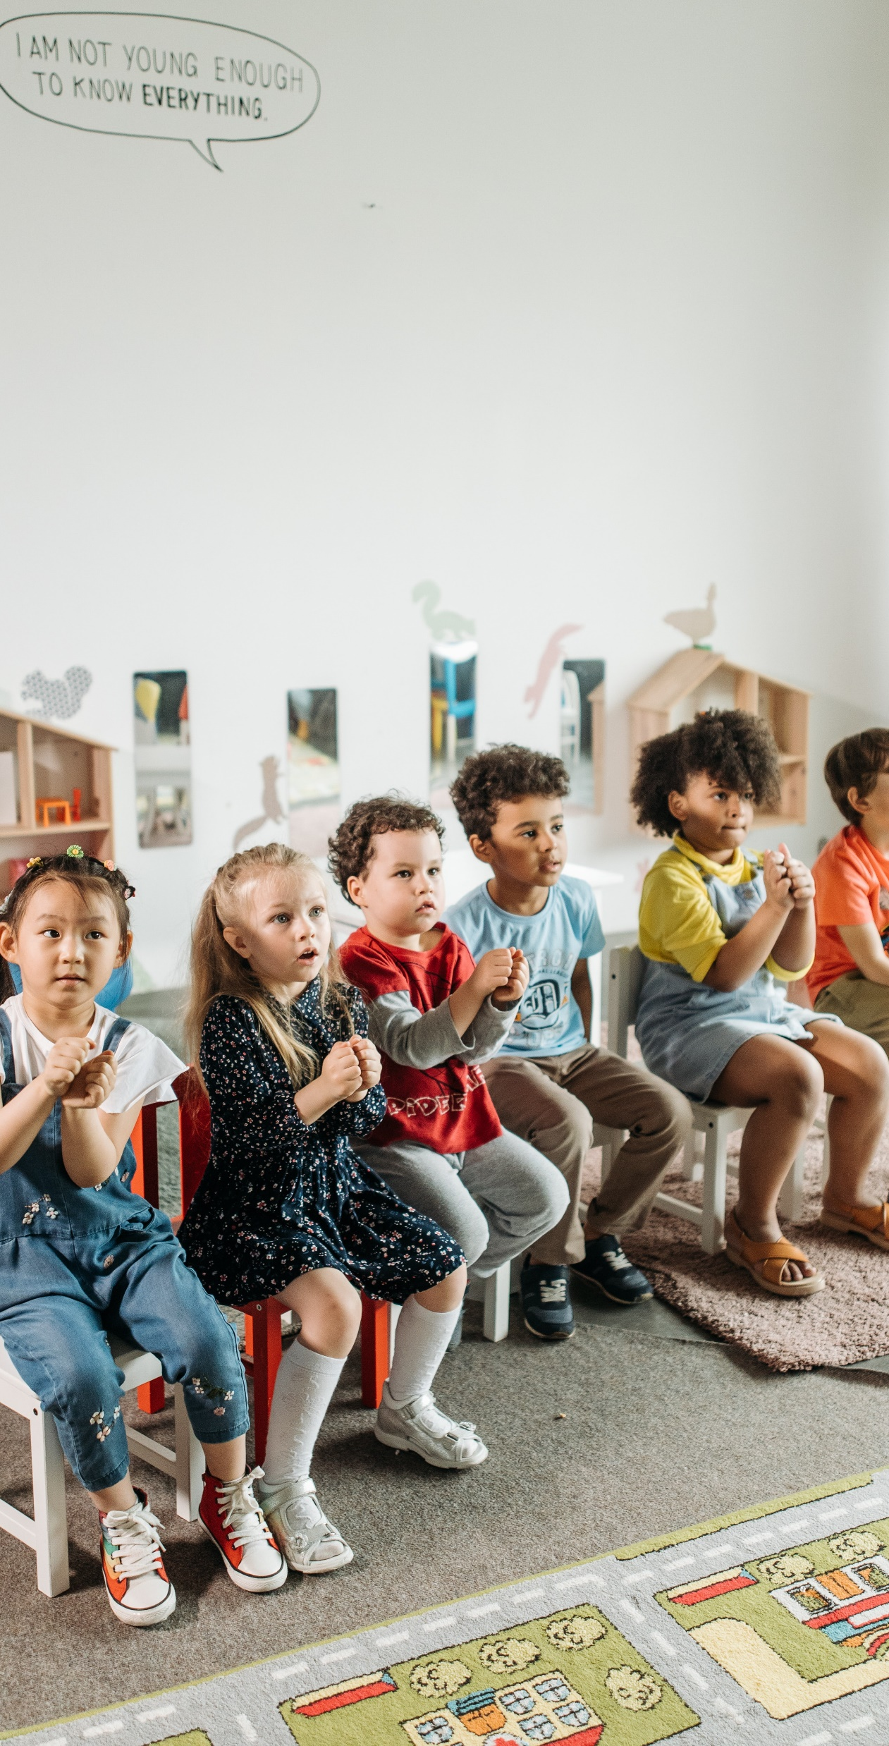
3) Measuring child cognitive behaviour
Measured by the Strengths & Difficulties Questionnaire – widely used measure of children’s emotional & behavioural problems.
Comprises five broad measures (domains) of cognitive behaviour:
  Emotional Symptoms (e.g., child has many fears, is easily scared)
  Conduct Problems (e.g., often lies or cheats)
  Hyperactivity/Inattention (e.g., overactive)
  Peer Problems (e.g., gets on better with adults than other children)
  Prosocial (e.g., shares readily with other children)
Notes:
NB Each item scored 0 = not true; 1 = somewhat true; 2 = certainly true (so each behavioural domain is on a scale of 0-10 points).

Slide 17
Model: Does paternal involvement affect attainment in the EYFSP at age five?
Control variables: Low household income (i.e. Below 60% of the median household income in the UK), gender and ethnicity of child, month & year of child’s birth, whether child lives with other siblings, quality of local area, housing tenure, father’s education, whether attended formal childcare before the age of 5

Slide 18
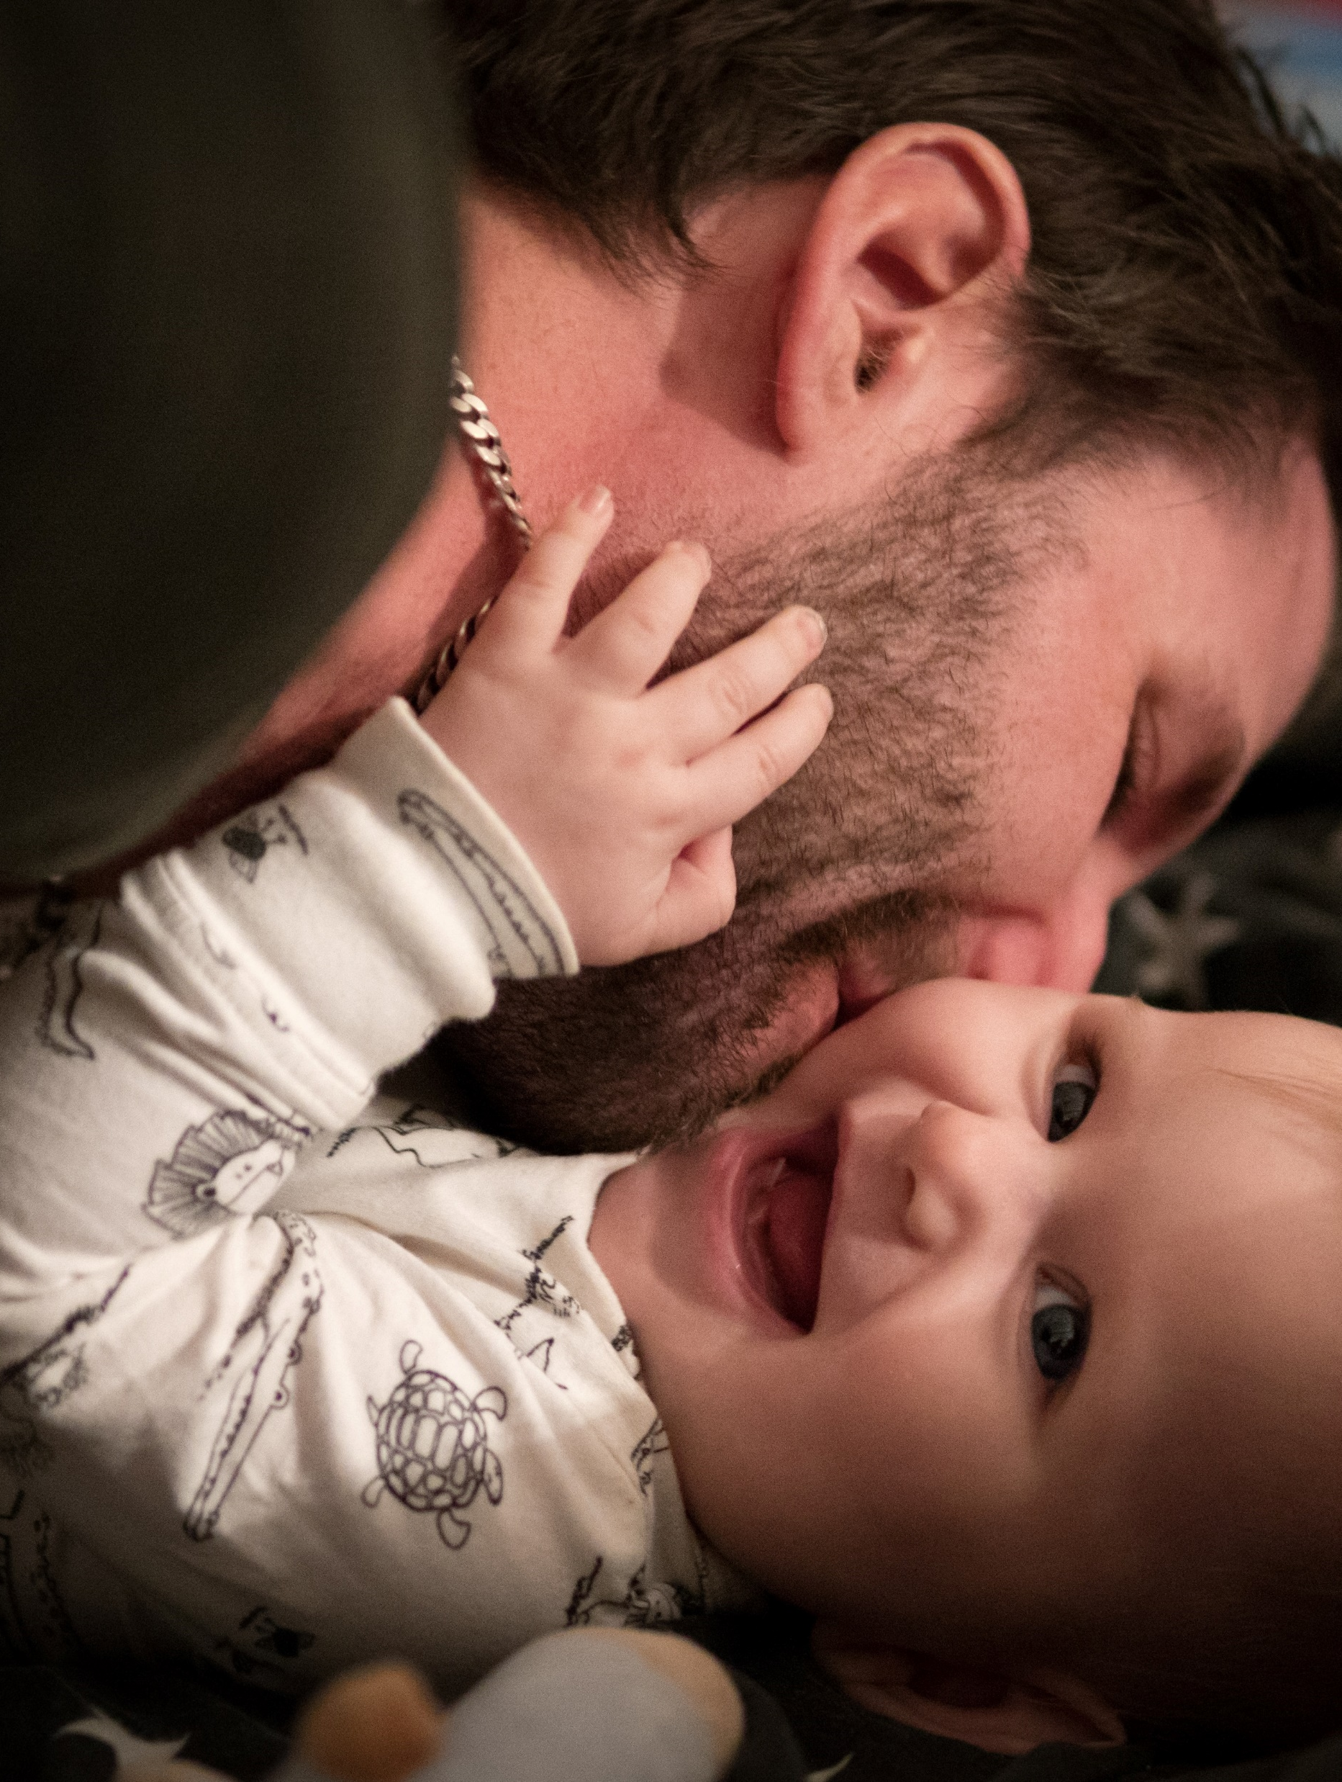
Findings

Slide 19

Does fathers’ involvement matter?
Fathers’ involvement has an important & unique effect on a child’s educational attainment, which operates in a different way to the mother’s involvement
  Pre-school involvement (at age 3) helps to increase a child’s educational attainment at age 5
  Involvement during the child’s first year of school (at age 5) helps to increase their educational attainment at this age
  Involvement in the first year of school (at age 5) helps to increase a child’s later attainment in their Key Stage Assessments at age 7

Slide 20

What about mothers’ involvement?
Mothers’ involvement affected the child in different ways – by helping to reduce problems with peer socialisation, emotional, conduct and hyperactive behaviour, as well as helping to enhance pro-social behaviour at age five.

Slide 21
% of children getting ‘good level’ of achievement (i.e., =>78 pts overall) in the Early Years Foundation Stage Profile at age 5 according to how often their father reads to them
Which involvement activities are most important?
Notes:
This data shows the % of children that got a good level of achievement in the EYFSP at age 5 (as per the Gov defn – scoring 78 points or more) according to how often their dads read to them.

Slide 22

What else affects educational attainment and behaviour?
Gender
Age (i.e., being older in the school year)
Attending pre-school formal childcare
Siblings
Father’s age
Quality of the local area
Household income/ poverty

Slide 23

The detrimental impact of poverty
Living in poverty continues to have a detrimental effect on educational attainment at school, and a scarring effect on a child’s attainment if this is experienced at a very young age:
  Educational attainment reduces if children live in a household with income below the poverty breadline
  Living in persistent poverty is associated with a child’s emotional symptoms & conduct, hyperactivity & peer socialisation problems
Mother involvement did help to reduce problematic emotional behaviour for children in poorer households

Slide 24

Summary
Greater father involvement in structured, educational activities (e.g., like reading & playing) provides an educational advantage to children in the early stages of primary school.
Fathers’ involvement throughout their child’s early and primary education can impact positively on their children’s educational attainment.
Mothers’ involvement operates differently – helping to enhance cognitive behaviour

Slide 25

Why is father involvement so important?
Two heads are better than one
  A father brings time, care and educational support in addition to that provided by the other parent
Fathers bring something different
  A father brings particular and unique benefits (especially as evidence shows fathers engage in different ways to mothers e.g., Pancsofar & Vernon-Feagans 2006; Allen and Daly 2007).

Slide 26

Limitations
Our measures do not capture everything!
Our models do not capture everything (e.g., school contextual influences)
Other types of families?
Old data?

Slide 27

Final remarks
The PIECE findings show that “in the context of 21st century UK parenting greater fathers’ involvement appears to provide an educational advantage to children, and this effect is important and seems to operate in different ways to the effects from the mothers’ involvement” (Norman and Davies 2023: p29).

Slide 28


Questions?
www.piecestudy.org
@PIECEstudy

Slide 29
Dr Jeremy Davies
Head of Impact and Communications - Fatherhood Institute
and Co-Investigator for the PIECE study

Slide 30

What we’ve learned about fathers’ school involvement and experiences of school-home support
Dr Jeremy Davies, Head of Impact & Communications, Fatherhood Institute

Slide 31
What do we know about fathers’ school involvement?
Key points
Parents’ engagement in activities that promote their children’s learning – such as reading and playing – can bring huge benefits to children’s educational development. And it’s clear that fathers’ engagement specifically is important, and needs our support.
But data from the Millennium Cohort Study also suggests that fathers are half as likely as mothers to participate in ’school involvement activities’ like helping out in the classroom, fundraising or being a school governor.
Why should we care about this?
  Because these activities demonstrate the value and importance of education to the child, which can have a positive influence on learning, behaviour and attendance (Campbell 2011)
  They may be an important step that leads to/enhances fathers’ engagement in children’s learning at home.

Slide 32
School-involvement
Activity | % of fathers involved | % of mothers involved
Help with fund-raising activities | 23 | 41
Help out in elsewhere in the school e.g. library | 7 | 30
Help out outside of class with special interest groups like drama/sports | 6 | 6
Some other activity (e.g. DIY, breakfast club) | 5 | 5
Be member of parent association, committee etc | 4 | 16
Help out in class | 4 | 20
Be member of management board/ governing body | 3 | 5
Across all the school-involvement activities measured by the Millennium Cohort Study (MCS) at age 7:
32% of fathers said they participated in their child’s school in some way, compared to 61% of mothers.
Notes:
These activities matter because they demonstrate the value and importance of education to the child, which can have a positive influence on learning, behaviour and attendance (Campbell 2011)
They may be an important first step that leads to/enhances fathers’ engagement in children’s learning at home.

Slide 33
Why do mothers get more involved in school life?
Key points
We found that barriers to fathers’ school involvement relate to income, time, work, educational and/or cultural background.
The same barriers hinder mothers’ school involvement. Yet despite this, mothers are much more likely to get involved at school compared to fathers. Why?
Dominant expectation that mothers take main responsibility – despite some shifts in social attitudes (Curtice at al, 2020)
Mothers may act as ‘education executives’ even where caring is shared (Brooks & Hodkinson, 2022)
Schools/early years settings can perpetuate this through their engagement practices; their assumption that mothers are (or should be) primarily responsible for managing and coordinating children’s care and education, may act as a barrier to fathers’ participation in school-involvement activities, helping ensure that on average fathers do less (Norman, Smith & Davies, 2023)
https://piecestudy.org/blog/supporting-fathers-to-get-more-involved-at-school/

Slide 34
Who does the school/setting contact about…
PIECE study Fathers & Children’s Learning Survey, 2022. N=178-184
Notes:
Our survey found a sizeable proportion of childcare providers and schools mostly or only contacting the mother about various aspects of school life, including sickness, homework and payment of bills.
48.6% did this when the child was sick.
43.9% did it about payments/ admin.
38.8% did it with invites to school events.
38.7% did it with instructions about activities to be done at home.
This was a small, self-selecting survey, and some of the dads who completed it – and who contributed to our consultation event – may have had particularly bad experiences. But this seems to be a substantive problem, and our report and toolkit suggest ways to solve it.

Slide 35
What communication methods do fathers prefer?
PIECE study Fathers & Children’s Learning Survey, 2022. N=184
Notes:
Fathers say they are open to lots of different methods.
Email was the most popular, but there is no clear ‘one size fits all’ approach.
In consultations, some dads said they preferred face to face interaction with the teacher/ practitioner.
The child living across households was also cited as a barrier. Targeting BOTH parents is likely to be particularly important for ‘own household fathers’ but also for including dads who might feel sidelined/pushed out

Slide 36
What areas do fathers want most help or guidance with?
PIECE study Fathers & Children’ Learning Survey, 2022. N=184
Notes:
Science and maths were the areas chosen by the highest proportion of fathers, where they felt like they wanted most help – more than two-fifths of dads chose these areas.
The least popular was reading – perhaps that’s an area where they feel most support is already provided? It’s also one where many are probably already involved. In our survey, 70% of fathers said they do this ‘often’. However ours was a self-selecting sample which may over-represent relatively ‘engaged’ fathers, and we note that 10% of fathers did admit ‘rarely or never’ reading with their children.
The other least popular area was creative arts activities – which, interestingly, is an area that 24% of fathers said they ‘rarely or never’ do with their children.

Slide 37
How can schools/settings best engage fathers?
Summary
Unpick and challenge the assumption that mothers are (or should be) primarily responsible for managing and coordinating children’s care and education
Ensure you have current contact details for all fathers, include ‘own household fathers’
Address fathers directly in communications, providing resources that encourage them to participate – in ‘school involvement’ and home learning activities
Run father-targeted events, and collaborate with diverse community partners (e.g. local gyms, sports clubs and mosques) to extend your reach
Remember that fathers (and mothers) don’t all have the same time and resources to support children’s education, and that individual and structural inequalities exist amongst different parent groups according to socio-economic status & ethnicity (Parentkind, 2021)
Design school-involvement activities that can be done from home, don’t eat time and money, and fit with diverse work schedules.

Slide 38
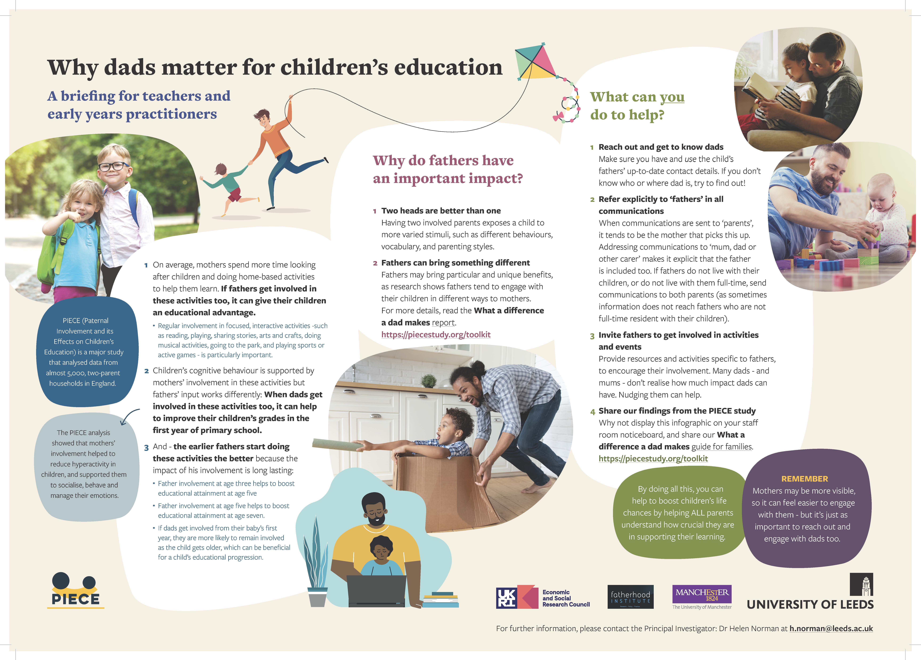

Resources – PIECE Report and Practitioner Briefing

Slide 39

Resources – Guide for Families
Download the Report, Practioner Briefing and Guide for families, from https://piecestudy.org/toolkit/

Slide 40
PIECE study
Q&A session (10 minutes)

Slide 41
Break (10 minutes)

Slide 42
Jeszemma Howl
Head of Training - Fatherhood Institute
Practice example – Fathers Reading Every Day

Slide 43

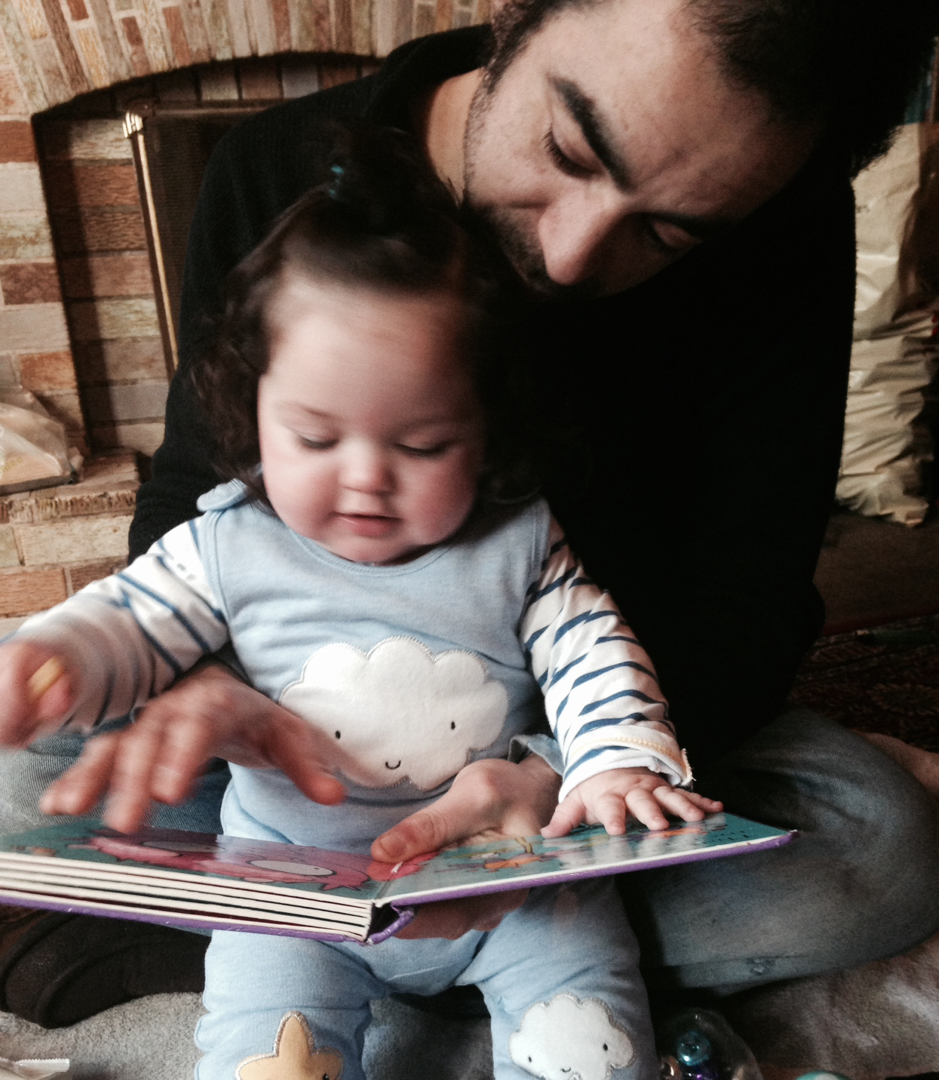


What can you do in ten minutes?
Results from a reading at home programme for fathers
Jeszemma Howl
Head of Training, Fatherhood Institute
j.howl@fatherhoodinstitute.org

Slide 44


10 Minutes to tell you why ten minutes matters
4 week home –based reading programme
Any Fathers and father-figures
Any age child
Nurseries, schools, libraries, family support, prisons, Big Lottery sites, Family Hubs
Notes:
Fathers Reading Every Day is a really simple programme that encourages dads to read with their children at home. It changes lives. Its effects are most powerful among children from disadvantaged backgrounds – and it’s brilliant with boys especially.

Slide 45

How it works
Fathers are given a reading diary
Ideas, tips and activities
Information on why this is important
Light-touch, positive, encouraging and celebratory
“I loved spending time with daddy”
“normally I wouldn’t get the opportunity to be read to and daddy enjoys me listening to him while he reads fantastic books.”

Slide 46

How it works
Fathers read at home with their children for set times per day
(average ten minutes a day, rising to 20 minutes)
Read anything, and anywhere
Read in any language
Jot down what they have read and for how long – all achievements are celebrated
Contact is made with fathers during the four weeks to see how they are doing
“Fathers Reading Every Day – enjoy it, do it with (child’s name). she asked me a lot about the stories I read. Laughing! And also good for the fathers, gives you confidence to play a role character of the story with (child’s name). I try to read every day since FRED!”

Slide 47
Reading with children
Involvement with their child's development and education
Relationship with services

Slide 48
Why?
Major studies across the world which follow families over time have found fathers’ involvement with their children linked with their higher educational achievement and higher educational /occupational mobility relative to their parents (Sarkadi et al, 2008; Flouri, 2005; Pleck & Masciadrelli, 2004).
When fathers of 1-2 year olds read lots of books to them, their children tend to be more interested in books later (Lyytinen et al, 1998).
Such early, sensitive involvement by dads continues to deliver benefits. At age 5, their children know and use more words, can pick out letters more accurately, and are better at problem solving; by 10, their vocabulary is wider and their maths skills are better (McKelvey et al, 2010).
Low interest by fathers in children’s education has a stronger negative impact on their achievement than does contact with police, poverty, family type, social class, housing tenure and child’s personality (Blanden, 2006).
Fathers are much less likely to receive targeted support, or to be actively recruited or addressed by family-focused support and interventions (see Burgess & Goldman, 2018; Panter-Brick et al, 2014; Child Safeguarding Practice Review Panel, 2021).

Slide 49
Outcomes (DfE pilot evaluation)
Fathers spent 70% more time reading to their children
FRED children were 4 times more likely than their peers to make greater-than-expected progress (rising two sub-levels): Reading (42% vs 11%) Numeracy (22 vs 9%) Writing (20% vs 15%)
Children on free school meals made the greatest progress
High numbers of boys took part
86% of dads who started FRED were still involved at the end of the programme
A third of FRED dads said they now spend more and better quality time with their children (most of these were relatively disengaged before FRED)

Slide 50
One setting: (180 children aged 3 – 6 years 86% EAL)
97% of fathers say taking part in FRED has helped them read to their child every day
96% say their child is choosing a book or something to look at or read more often
96% say they have noticed their child having longer conversations AND using new words or phrases
91% say they feel more ‘connected’ (knowing when they need quiet time, a cuddle, eye contact, understanding their ‘mood’ etc) with their child
87% speak to, sing and/or laugh more with their child AND FEEL more confident in reading books or telling stories with their child
Books were read 2486 times throughout one round of FRED

Slide 52
Listening and attention: % achieving or exceeding expected progress

Slide 53
Managing feelings and behaviour: % achieving or exceeding expected progress

Slide 54
Making relationships: % achieving or exceeding expected progress

Slide 55
What fathers say…
“I feel more confident and also FRED encouraged me to read with the child. It's helped me and awoken me to do so which is very good”.
“I would definitely encourage more Fathers to take part in FRED. I can't read very well and I don’t normally look at books but looking at the books with my children has definitely helped me and I feel more confident to pick a book up with them now.”
“The Fred reading gave me confidence, the information I was given regarding reading to my children and how important it is. Has given me courage and a closer bond. And as a family we have a better going to bed time routine. We will be joining the library.”
“I didn't have much of a bond with my youngest 2 as they was all mum. Now I look forward to story time and enjoy that 2 hours daddy time just to relax with them. loved that I had something to show at the end and my child now comes to dad with a book at 11am and 6pm.”

Slide 56
Outcomes for children
Father-child relationships
Involvement with services
Early involvement pays dividends…
For more information, search for FRED
www.fatherhoodinstitute.org
j.garratt@fatherhoodinstitute.org

Slide 57
Panel Discussion
Sian Lewis, Head of Parent Participation, Parentkind
Tom Harbour, Chief Executive Officer, Learning with Parents
Liz Ersoy, Training and Accreditation Manager, Peeple
Sergei Urban, Founder, TheDadLab
Umar Kankiya, Media Lead, Dope Black Dads

Slide 58
Event close
Dr Helen Norman – Principal Investigator

