Slide 1
Fathers’ engagement in low-income households and the effects on children’s attainment at primary school
Helen Norman & Rose Smith
Centre for Employment Relations, Innovation and Change (CERIC)
British Sociological Association Conference: Sociological Voices in Public Discourse
12-14 April 2023

Slide 2
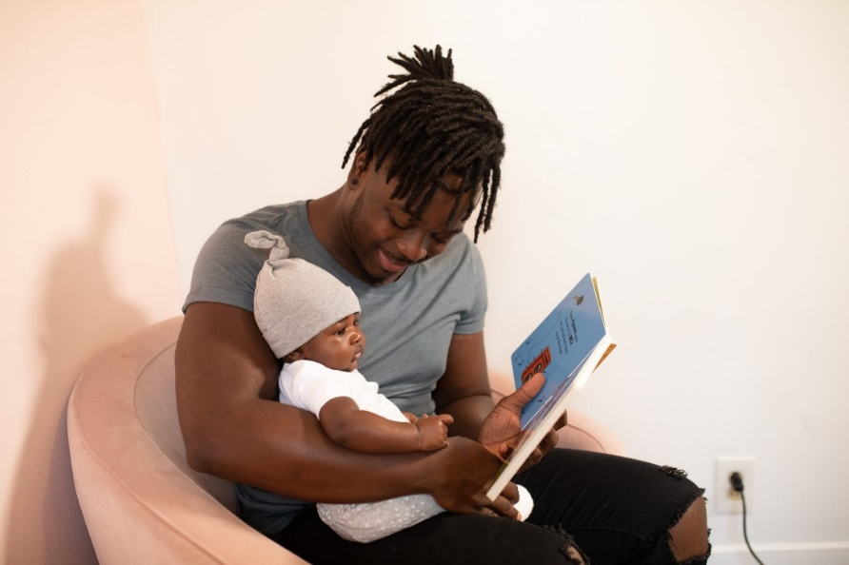
Presentation Outline
Background
PIECE project
Data
Summary of headline findings from PIECE so far
Exploring the relationship between poverty, parental involvement and educational attainment
Summary of findings
Concluding remarks

Slide 3
Background
Parental childcare involvement is critical for supporting children’s education and learning
  Engagement in educational or structured activities is associated with better primary school grades & cognitive skills (e.g. Del Bono et al 2016; Hsin and Felfe, 2014)
But this evidence is largely based on research with mothers or ’parents’
We know less about whether and how fathers impact on children’s education, independently of mothers
Does paternal childcare involvement have different consequences for child development?

Slide 4
Why is this important?
Attainment at an early stage shapes educational pathways and future prospects in employment (e.g. GEO 2019; Hutchinson 2019)
Over a quarter of children in England not primary ‘school-ready’ (DfE 2018)
UK ranked in the bottom third of 41 of the world’s richest countries for inequalities in primary school education (UNICEF 2018)
Boys underachieve at every level (e.g. Moorhead 2019)
Girls are unrepresented in science and maths (e.g. Weale 2018)
Children from poorer families do less well than their more affluent peers (e.g. Hutchinson 2019)
  E.g. At the end of primary school, poorer children are about 9 months behind their more affluent peers (Education Policy Institute 2020)

Slide 5

Research Questions
Does paternal childcare involvement increase primary school attainment for children?
Does father involvement moderate the known detrimental effects from household poverty on attainment?

Slide 6





Funded by the ESRC Secondary Data Analysis Initiative
1 April 2022 – 30 June 2023
Dr Helen Norman (PI), Leeds University Business School
Dr Jeremy Davies (Co-I), Fatherhood Institute
Professor Mark Elliot (Co-I), University of Manchester
Professor Colette Fagan (Co-I), University of Manchester
Dr Rose Smith (Research Fellow), Leeds University Business School
www.piecestudy.org
@PIECEstudy

Slide 7
Data
First 3 sweeps of the Millennium Cohort Study:
Linked to the Early Years Foundation Stage Profile (age five)
Sample: 4,966 two-parent, opposite sex households in England who are intact for the first 5 years of a child’s life
Sweep | Date | Child’s age
1 | 2000-02 | 9 months
2 | 2004 | 3 years
3 | 2006 | 5 years

Slide 8
Measuring Father and mother childcare involvement
How often do you do the following with your child:
Read [READ]
Tell stories [STORY]
Play music, sing songs, dance, musical
activities [MUSIC]
Play toys or games indoors [TOYS]
Play sports/physically active games outdoors [GAME]
Take your child to the park or outdoor playground [PARK]
Draw, paint, make things [PAINT]
*All measured on a Likert scale: 1 = Not at all; 2= Less often than once a month; 3 = Once or twice a month; 4 = Once or twice a week; 5 = Several times a week; 6 = Everyday or almost everyday.

Slide 9
Measuring ‘Attainment’:
EY Foundation Stage Profile (FSP) (age 5)
Area of learning | 13 Assessment scales
Personal, social & emotional development | Disposition & Attitudes Social Development Emotional Development
Communication, Language and Literacy | Language for communication & thinking Linking sounds and Letters Reading Writing
Mathematical development | Numbers as Labels & for Counting Calculating Space, Shape & Measures
Knowledge & Understanding of the World | Knowledge & Understanding of the world
Physical Development | Physical Development
Creative Development | Creative Development

Slide 10
RQ1 Does father involvement increase primary school attainment?
Fathers involvement has a positive effect on children’s educational attainment at age five, over and above the effect of the mother’s involvement
Mothers involvement affected the child in different ways like enhancing a child’s good (e.g. emotional and prosocial) behaviour
  Results available from: https://piecestudy.org/wp-content/uploads/2022/07/Natcen_2022_H-Norman_final_.pptx

Slide 11
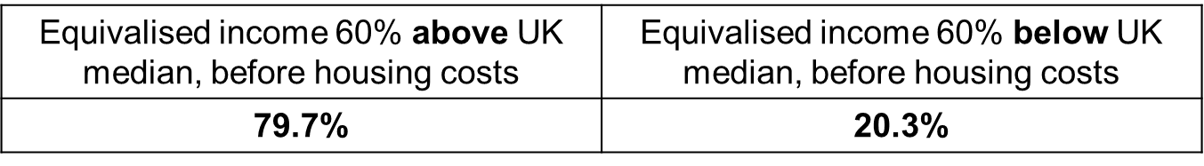
Extending the analysis – the effect of poverty
Fathers’ involvement has a positive effect on educational attainment
Poverty has a negative effect on educational attainment
Do these things interact?
  RQ2: Does fathers’ involvement help to moderate the negative effects from poverty?
New variable:
POVERTY STATUS - Organisation for Economic Cooperation (OECD)
n=4,966

Slide 12
Level of (i) fathers and (ii) mothers’ involvement by poverty status (%)
(i) FATHERS
(ii) MOTHERS

Slide 13
Results: The effect of father involvement (FINV), mother involvement (MINV) and poverty status on attainment
NS = Not significant
** sig (p<0.01)
CONTROL VARIABLES: Gender and ethnicity of child, child’s age, whether child lives with other siblings, quality of local area, housing tenure, father’s education level, whether child attended formal (ECEC) childcare before the age of five, fathers work hours, mothers’ work hours, father’s age

Slide 14
Results: The moderating effect of father & mother involvement (FINV/MINV) on attainment
NS = Not significant
** sig (p<0.01)
* sig (p<0.05)
CONTROL VARIABLES: Gender and ethnicity of child, child’s age, whether child lives with other siblings, quality of local area, housing tenure, father’s education level, whether child attended formal (ECEC) childcare before the age of five, fathers work hours, mothers’ work hours, father’s age

Slide 15
Summary
Fathers involvement has a positive effect on educational attainment at age five – even when we control for poverty status
  But it does *not* moderate the negative effect of poverty on educational attainment
Mothers’ involvement has a significant moderating effect on the relationship between poverty and attainment
  i.e. Higher levels of mothers’ involvement within households that are poor helps to reduce the negative effect of poverty on children’s educational attainment

Slide 16
Concluding remarks
Fathers and mothers’ involvement has different effects on a child and their educational development hence why supporting both parents to be involved caregivers is important
But we note:
Father and mother experiences of poverty are complex so the conditions under which this impacts on children will be varied and diverse (e.g. see Tarrant 2021)
MINV is not the solution to addressing socio-economic inequalities in education!
Our analysis establishes associations (not causation) in the data - there will be other factors impacting on the relationship between poverty and academic attainment
But this analysis does provides a foundation for further research in this area e.g. interesting to explore how parental involvement operates at different levels of socioeconomic status

Slide 17
Reference –
Data for the linked MCS-NPD
University College London, UCL Institute of Education, Centre for Longitudinal Studies, Department for Education. (2021). Millennium Cohort Study: Linked Education Administrative Datasets (National Pupil Database), England: Secure Access. [data collection]. 2nd Edition. UK Data Service. SN: 8481, http://doi.org/10.5255/UKDA-SN-8481-2

Slide 18

Thank you!
www.piecestudy.org
@PIECEstudy

Slide 19
APPENDIX: Why might fathers have a unique effect?
Exposure to more words, vocabulary and language e.g. children have higher vocabularies & more complex language skills the more their fathers talk to them (e.g. Cabrera et al. 2018)
Fathers are involved in different ways to the mother e.g. greater physical engagement is more likely to promote risk-taking and problem-solving (e.g. Allen and Daly 2007; Roggman et al 2004).
  E.g. Fathers can help with role-modelling behaviour, which can enhance cognitive development & social competence
The mental load impacts more on mothers (e.g. see Dean et al 2021) and so is less likely to interact with father engagement

